Slide 1
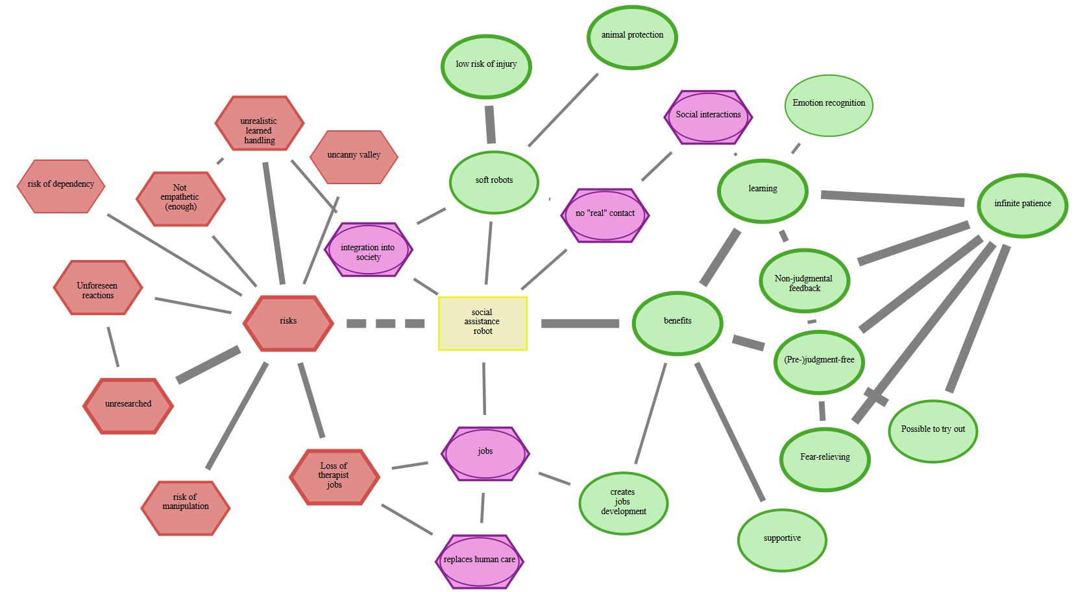
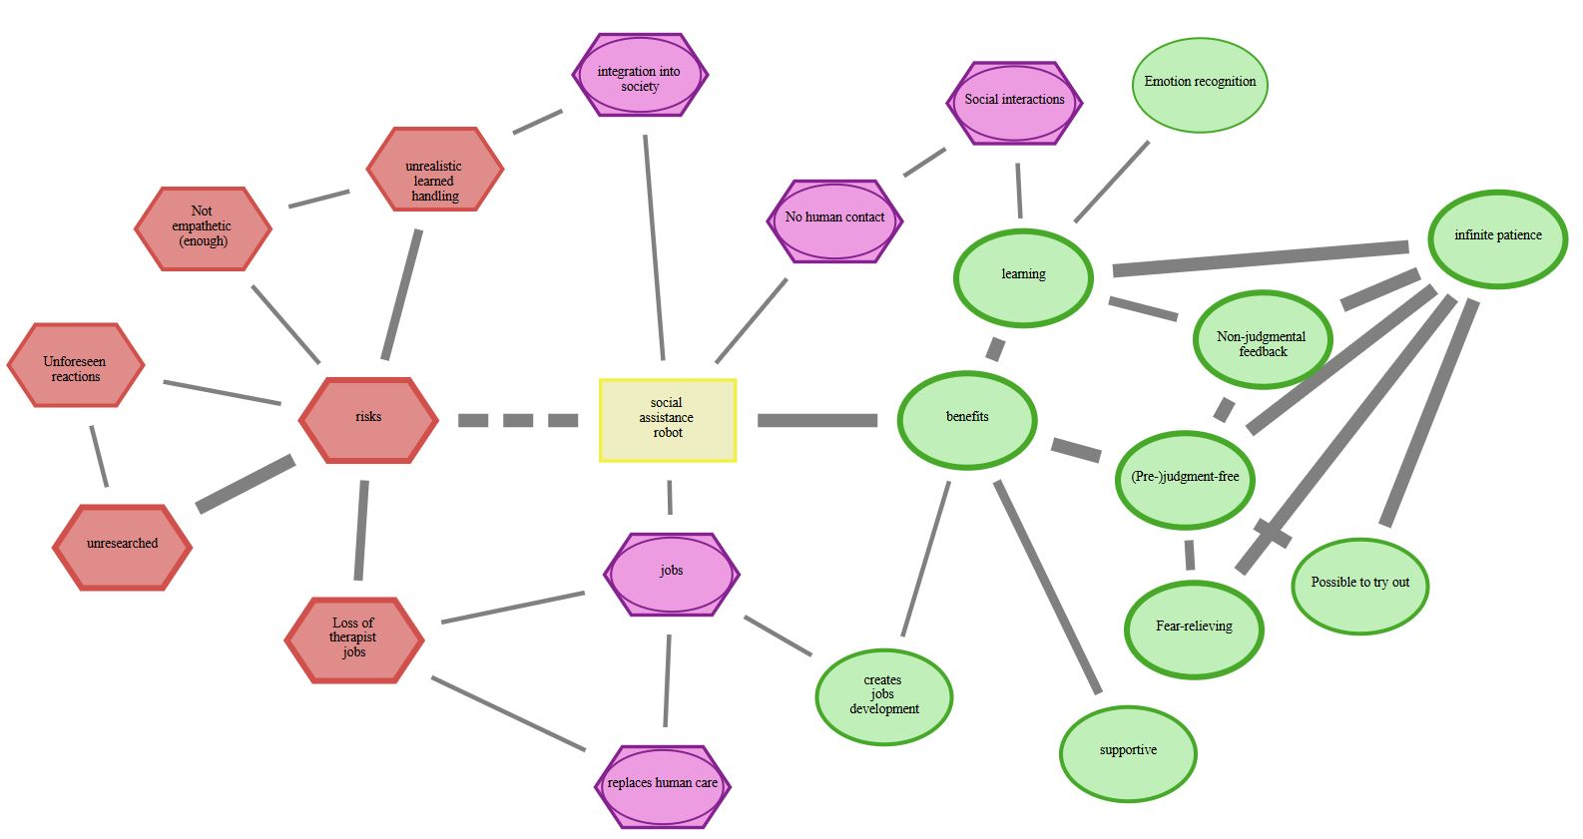


Rigid RR
Soft RR
Draw CAM
Adjust drawn CAM
Rigid SAR
Soft SAR
“deleted” (D)
“new” (N)
Added (N) and deleted (D) concepts
D
$$C_{1}$$
N
$$C_{2}$$

